Slide 1
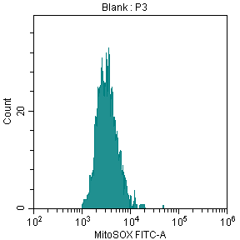
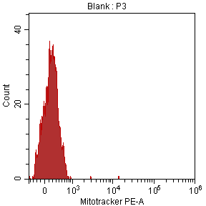
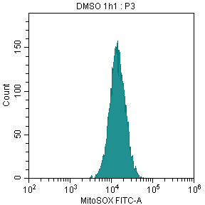
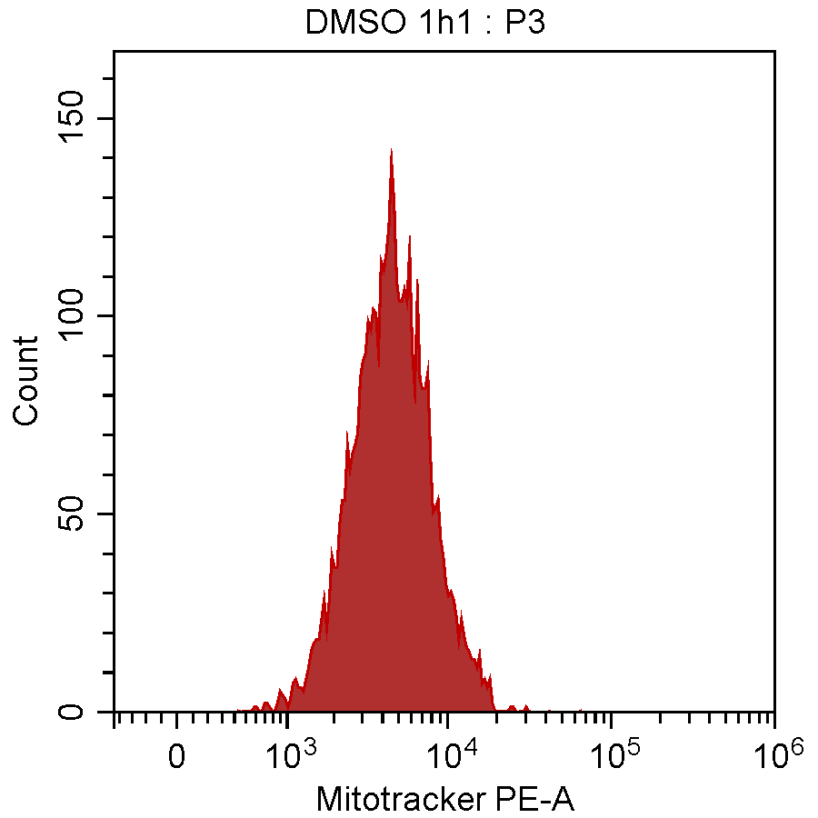
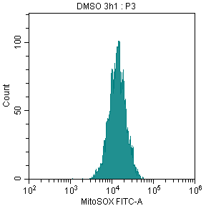
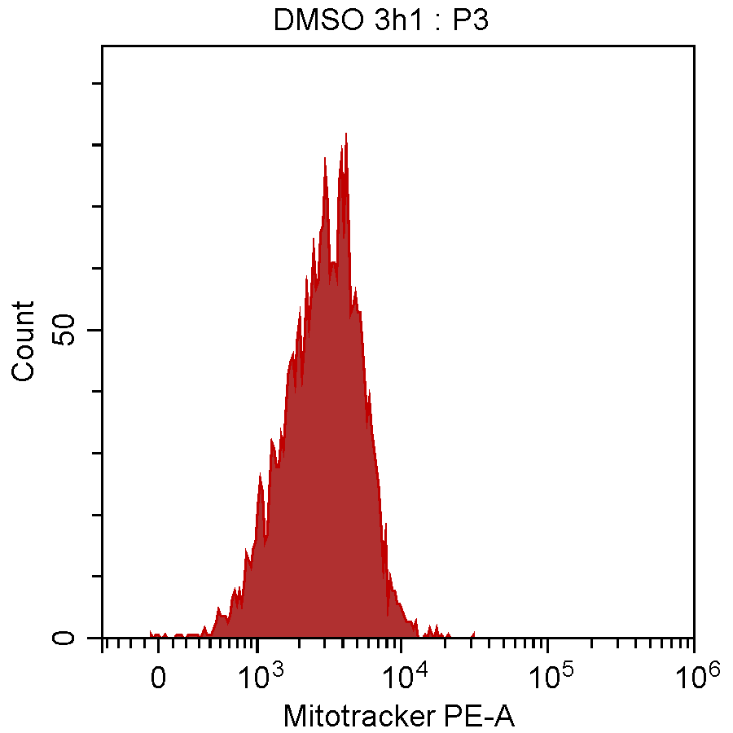
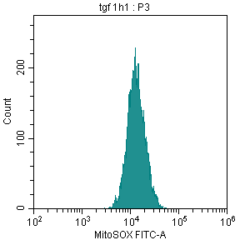
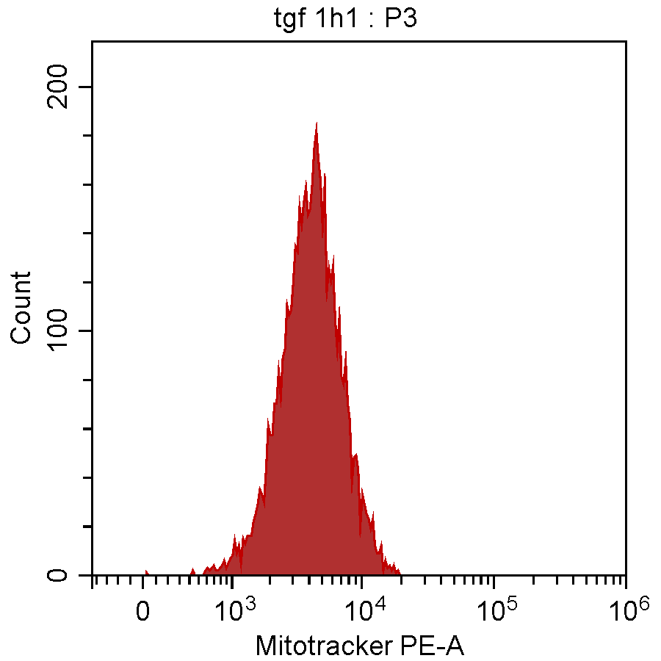
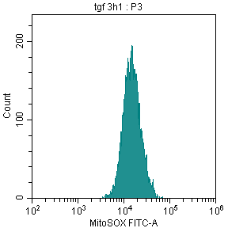
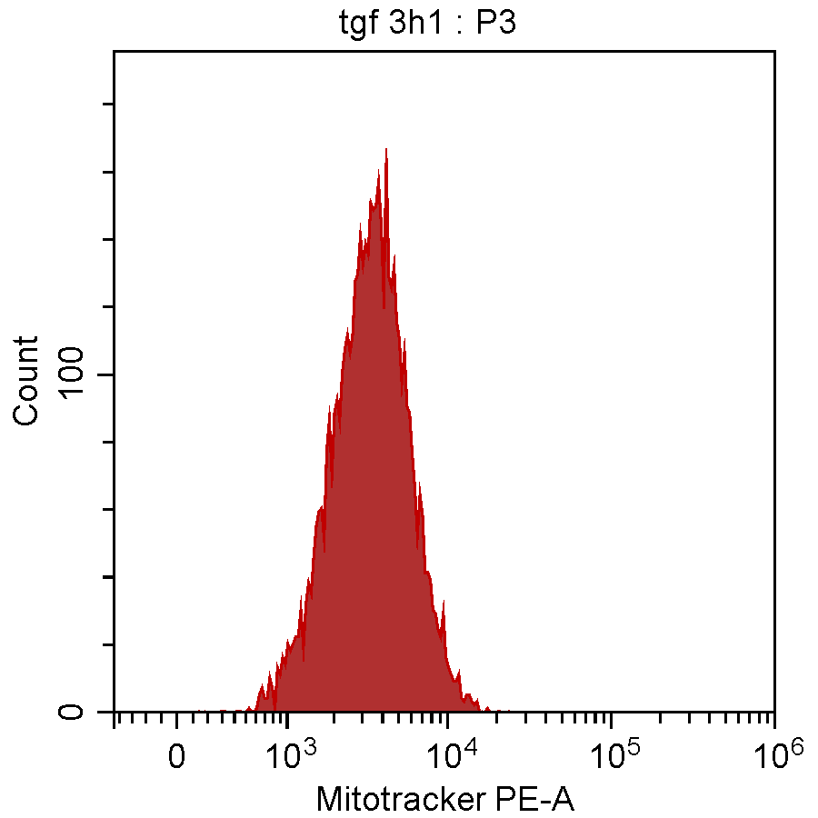
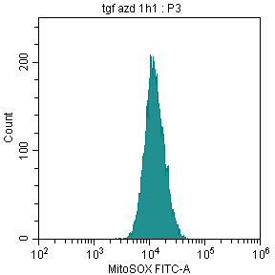
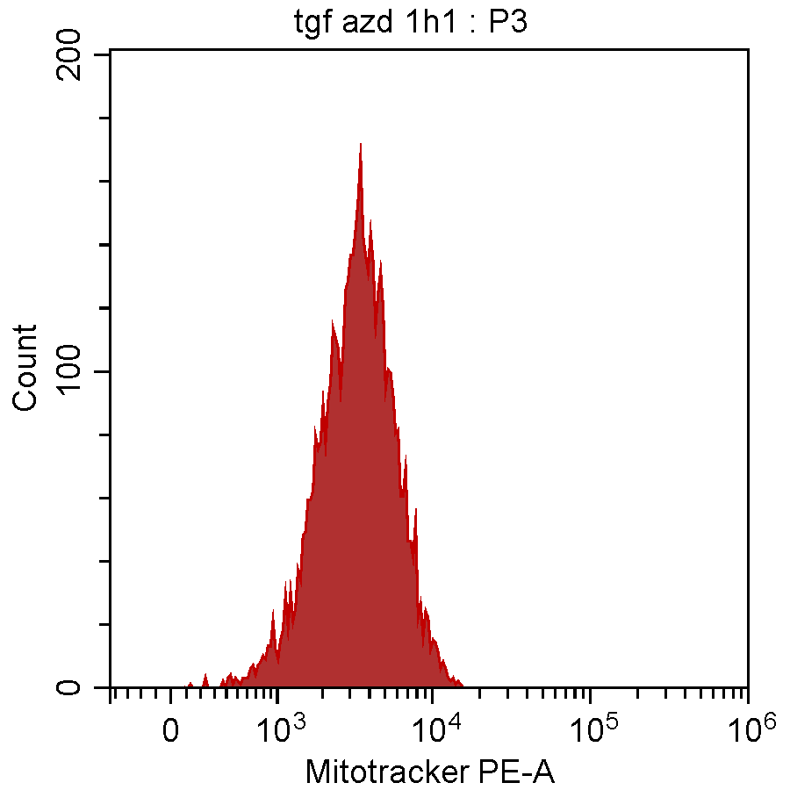
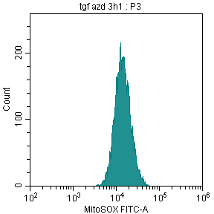
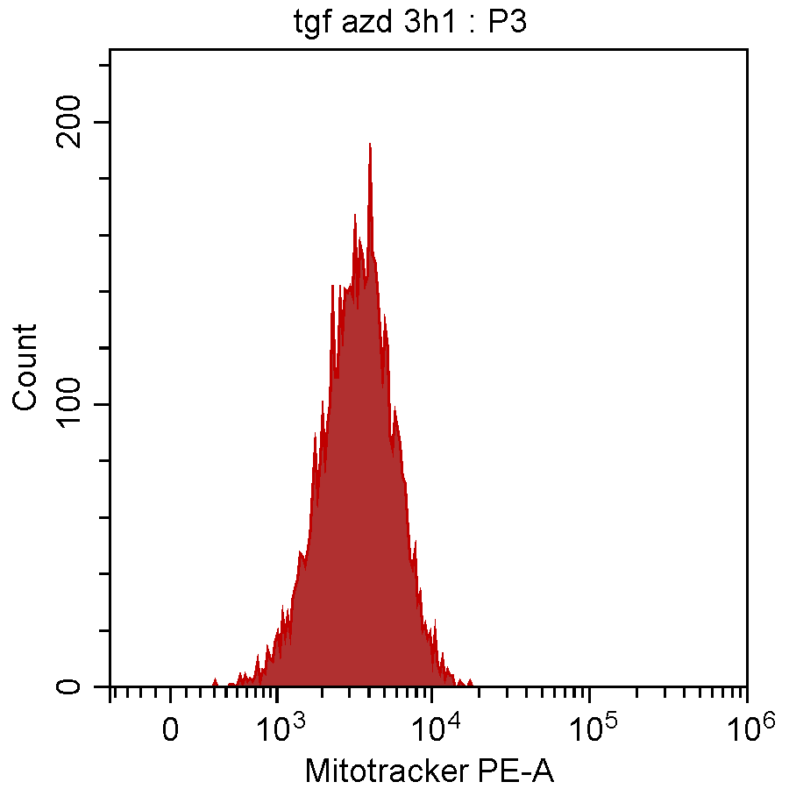
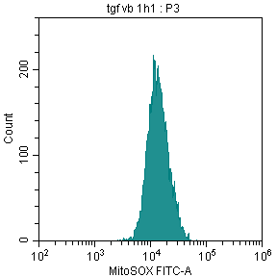
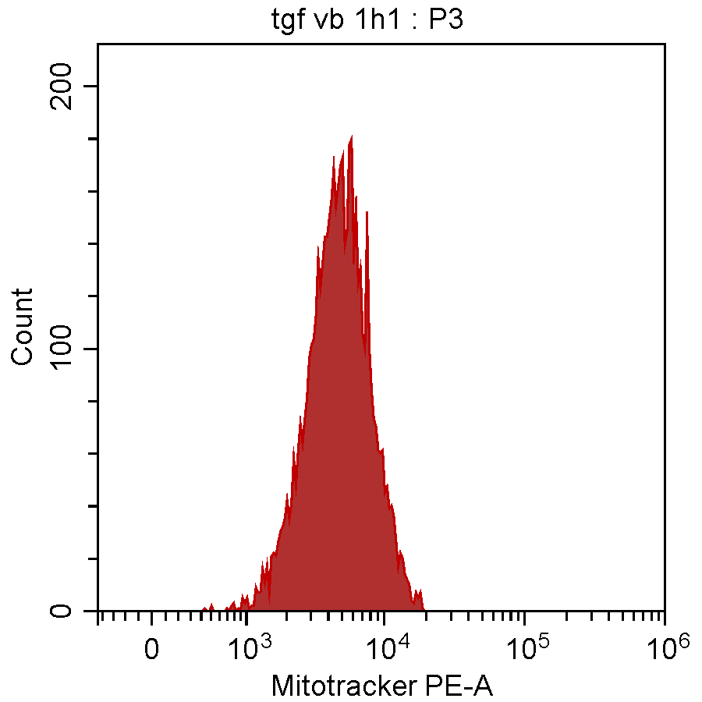
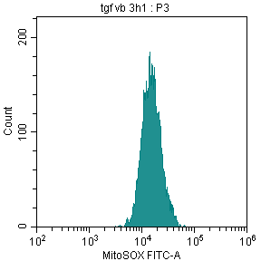
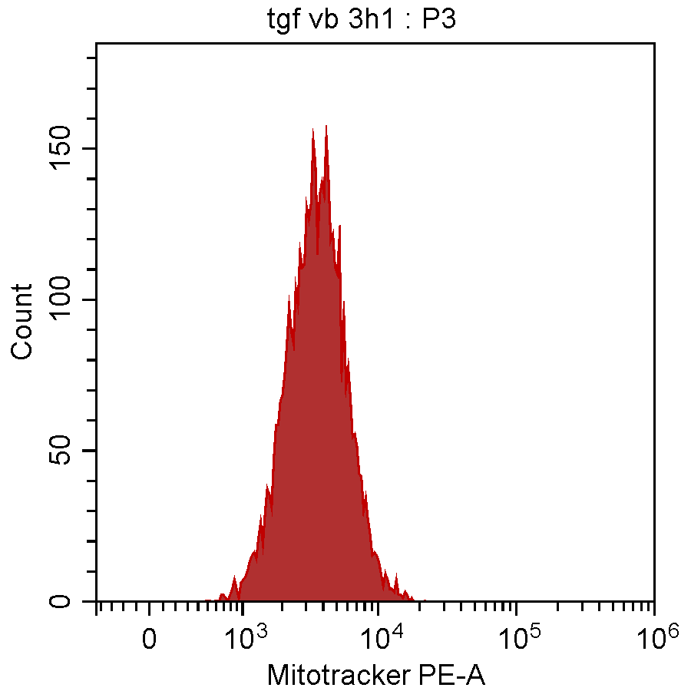
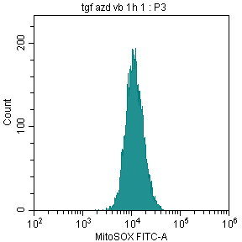
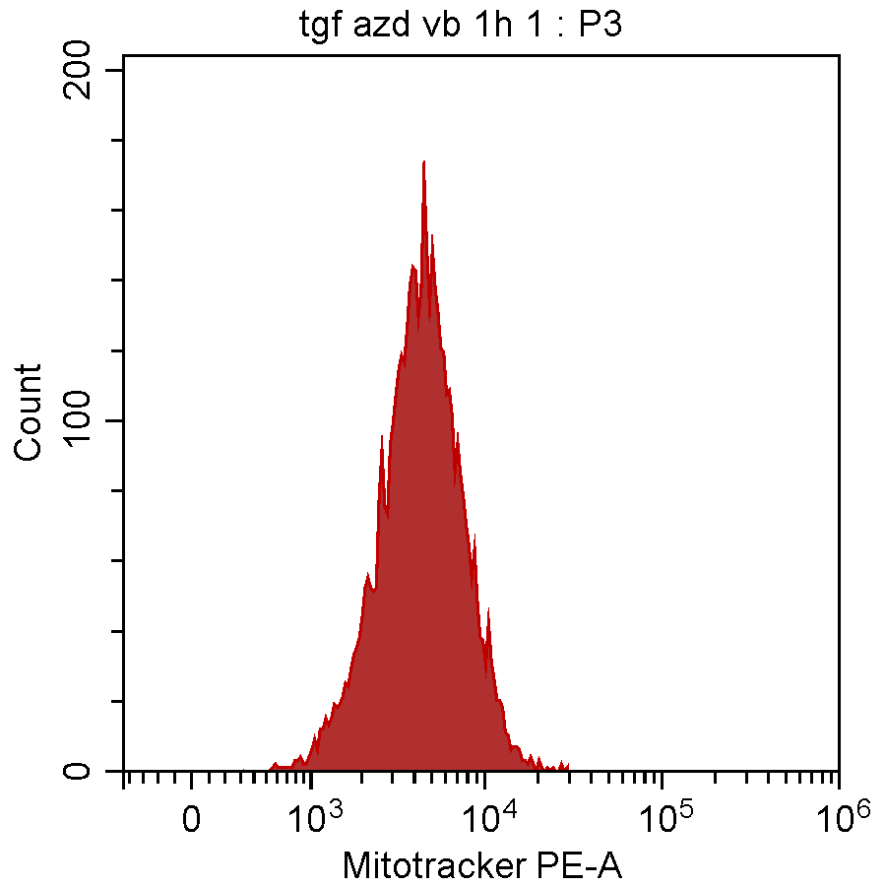
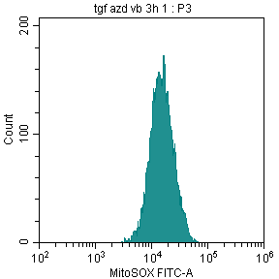
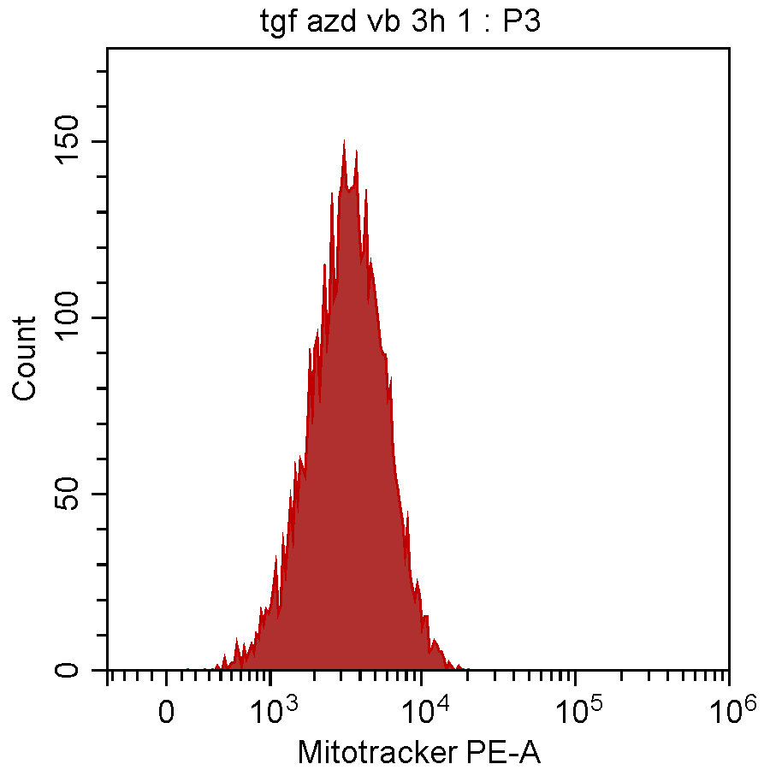
MitoSOX
MitoTracker
Seed cells in 24 well-plates (each group 3-4 samples)
Blank
Starvation
DMSO 1h
Pre-treatment with inhibitors (3h group)
DMSO 3h
TGFβ (3h group)
TGFβ 1h
Pre-treatment with inhibitors (1h group)
TGFβ (1h group)
TGFβ 3h
Wash with warm FBM
TGFβ+AZD 1h
MitoSOX/Mitotracker for 30 min
TGFβ+AZD 3h
Wash with warm FBM
TGFβ+VB 1h
Trypsin, complete medium
TGFβ+VB 3h
Centrifuge, cold PBS wash x2
TGFβ+AZD/VB 1h
Suspend in 200 ul PBS with DAPI
Flow Cytometry, Mean fluorescence intensity of FTIC/PE/PB450
TGFβ+AZD/VB 3h
Gated on DAPI- NHLFs

Slide 2
MitoSOX 01-24-24

Slide 3
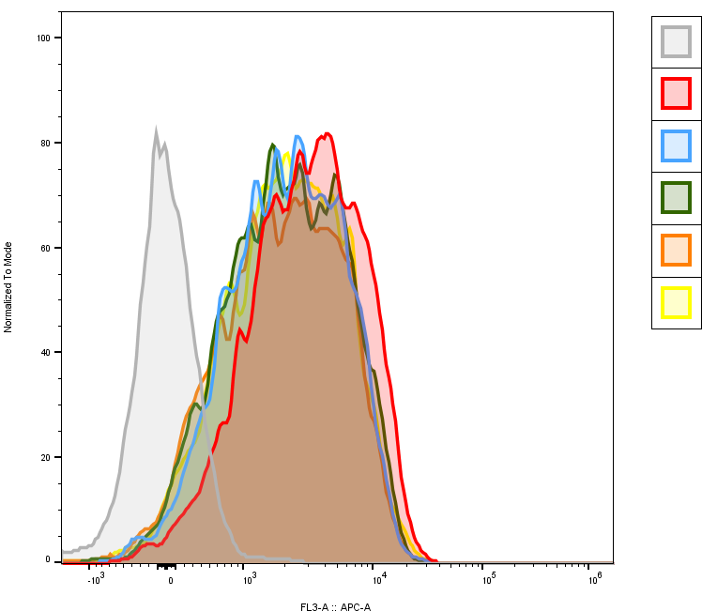
1. Experiment 1 11-17-23 （ Trypsin then staining in flow tubes）
FlowJo analysis
Blank
DMSO 1h
TGFβ 1h
TGFβ+AZD 1h
TGFβ+VB 1h
TGFβ+AZD/VB 1h
CytExpert software

Slide 4
2. Experiment 2 12-14-23 （ staining in wells then collection）
FlowJo analysis
CytExpert software
3. Experiment 3 01-19-24（ staining in wells then collection）
FlowJo analysis
CytExpert software

Slide 5
CellROX 6h. 01-30-24（ staining in wells then collection）
CytExpert software

